Slide 1

Crop Production Analysis in India
data analysis
Mandla Jagadish

Slide 2

Introduction
Agriculture is a crucial sector in India, contributing significantly to the GDP and employment.
The project aims to Visualize crop production and identify key indicators and metrics influencing crop production.
The dataset spans multiple years and includes details on crop production across various states and districts in India.
Data
Visualization

Slide 3
Analyzing data enables informed decision-making
Dataset Overview
Columns :
State_Name: Name of the state.
District_Name: Name of the district.
Crop_Year: Year of crop data.
Season: Season (e.g., Kharif, Rabi).
Crop: Type of crop.
Area: Area cultivated (in hectares).
Production: Crop production (in tons).
Data
Data analysis helps uncover valuable insights from complex datasets
Visualization

Slide 4
Data Cleaning and Transformation
Filled missing values in the Production column with the median value.
Ensured all columns have appropriate data types (e.g., integers for years, floats for production).
Identified and removed duplicate rows to ensure data consistency.
Aggregated data to get total production by year, state, and crop.
Created additional features like production per area for deeper insights.
Visualization
Data
Statistical techniques play a crucial role in data analysis

Slide 5

Total Production Calculation
DAX Formula in Power BI to calculate total production:
Total Production = SUM('CropProductionData'[Production])
This measure dynamically calculates the total production from the dataset.
Statistical techniques play a crucial role in data analysis

Slide 6
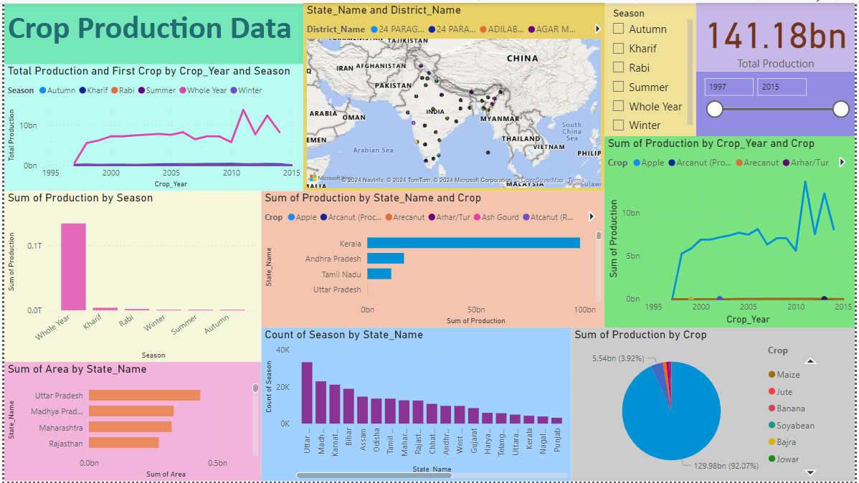

Slide 7
Conclusion
Data Cleaning:
Handled Missing Values: Filled missing values in the Production column with the median.
Data Type Verification: Ensured appropriate data types for each column.
Removed Duplicates: Identified and removed duplicate rows.
Data Transformation:
Aggregation: Aggregated data to get total production by year, state, and crop.
Feature Engineering: Created additional features like production per area for deeper insights.
Visualization in Power BI:
Line Chart: Displayed crop production trends over the years.
Bar Chart: Compared crop production across different states.
Pie Chart: Showed the proportion of different crops produced.
Map Visualization: Displayed crop production by district.

Slide 8

Thanks
Mandla Jagadish

